Slide 1

Introduction
PARADISE
Supervisor: Mr. Cat Nghiem Hieu Tuan
Le Cong Dat – Student1022144
Tran Thi Tuyet Duyen – Student1030933
Tran Tan Duy – Student1053750
22 May 2019

Slide 2
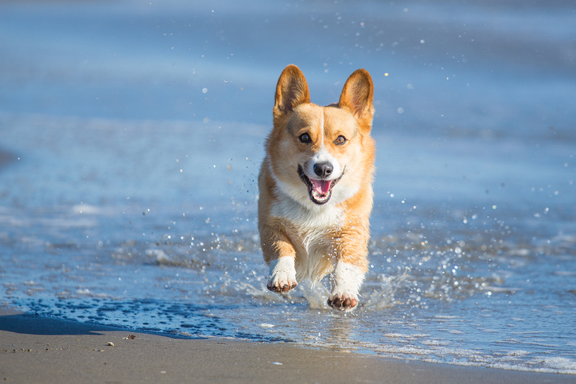
PET?

Slide 3

HOW MUCH?

Slide 4

LUXURY

Slide 5


Slide 6

Busy life

Slide 7

Boring life

Slide 8


Slide 9


Slide 10
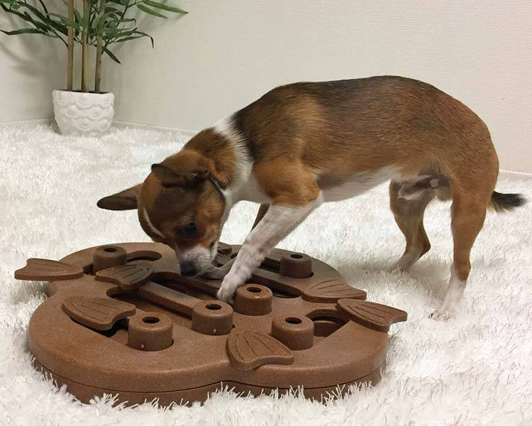
Playing on their own

Slide 11
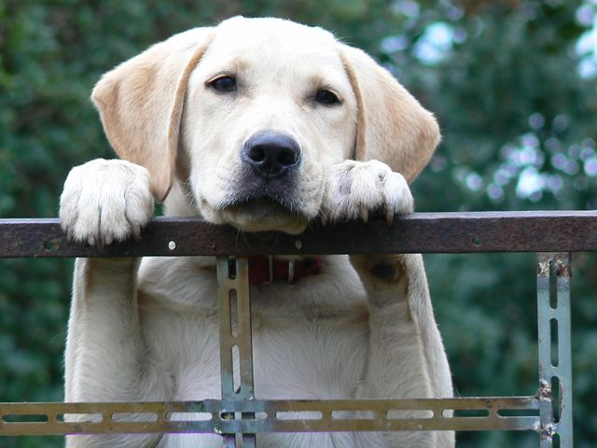
I want some friends

Slide 12


Thinking???

Slide 13

We are here
Pets
Paradise

Slide 14
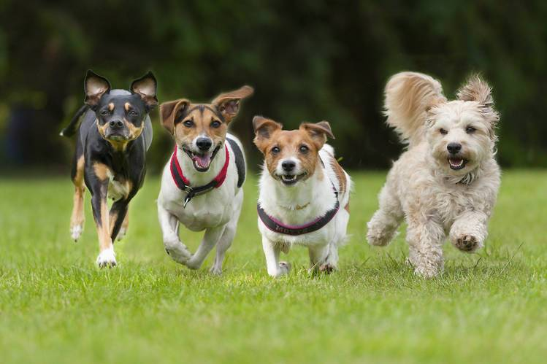
Playing together

Slide 15

happy together

Slide 16
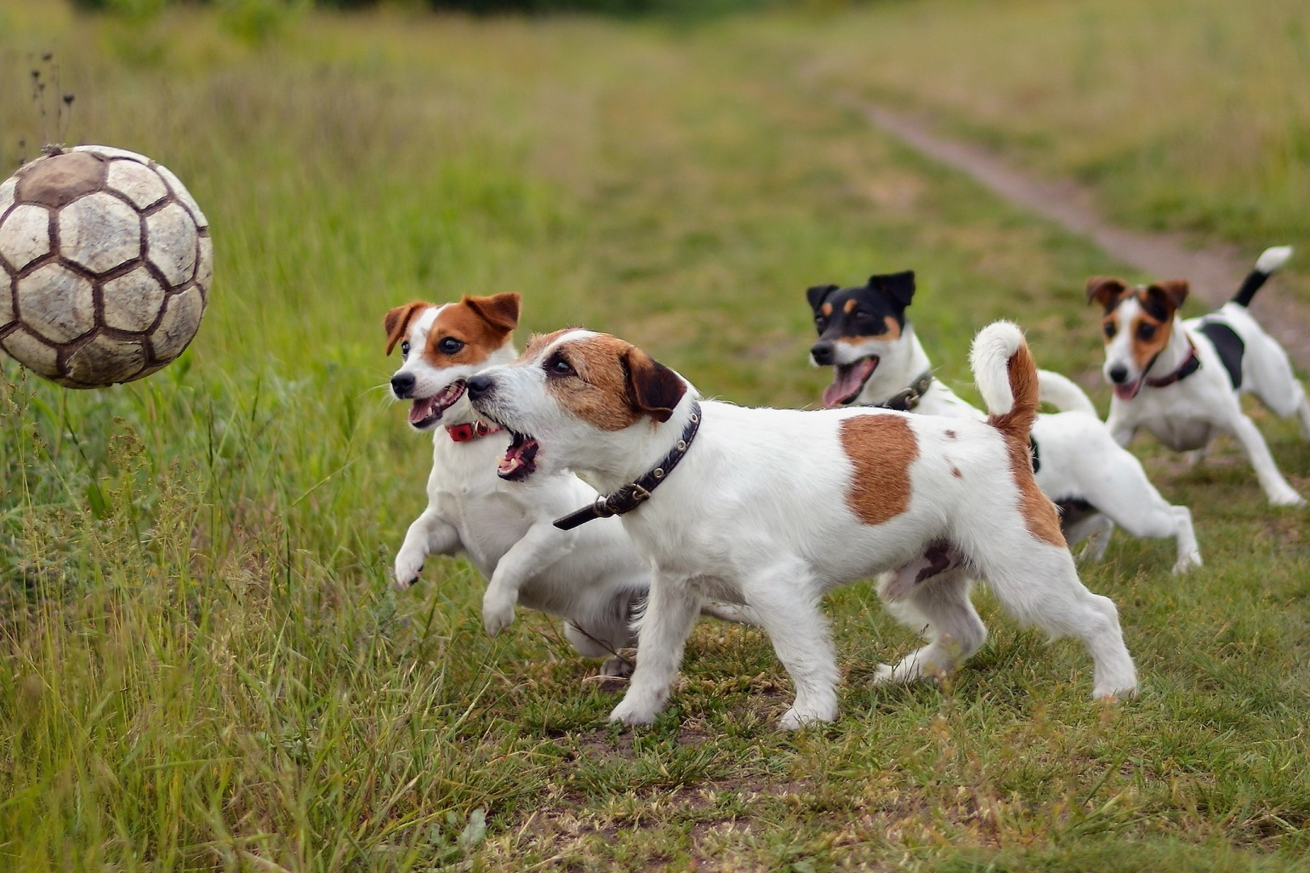
Playing together

Slide 17
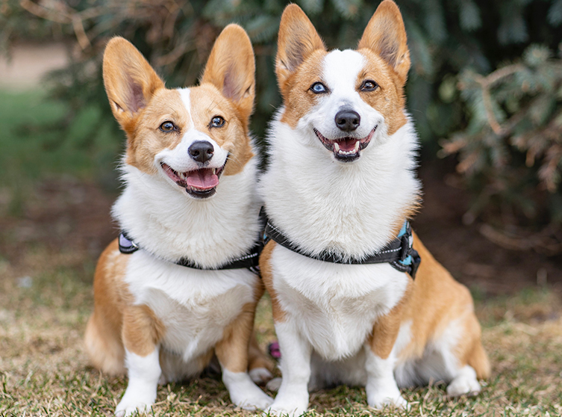
LOVE

Slide 18
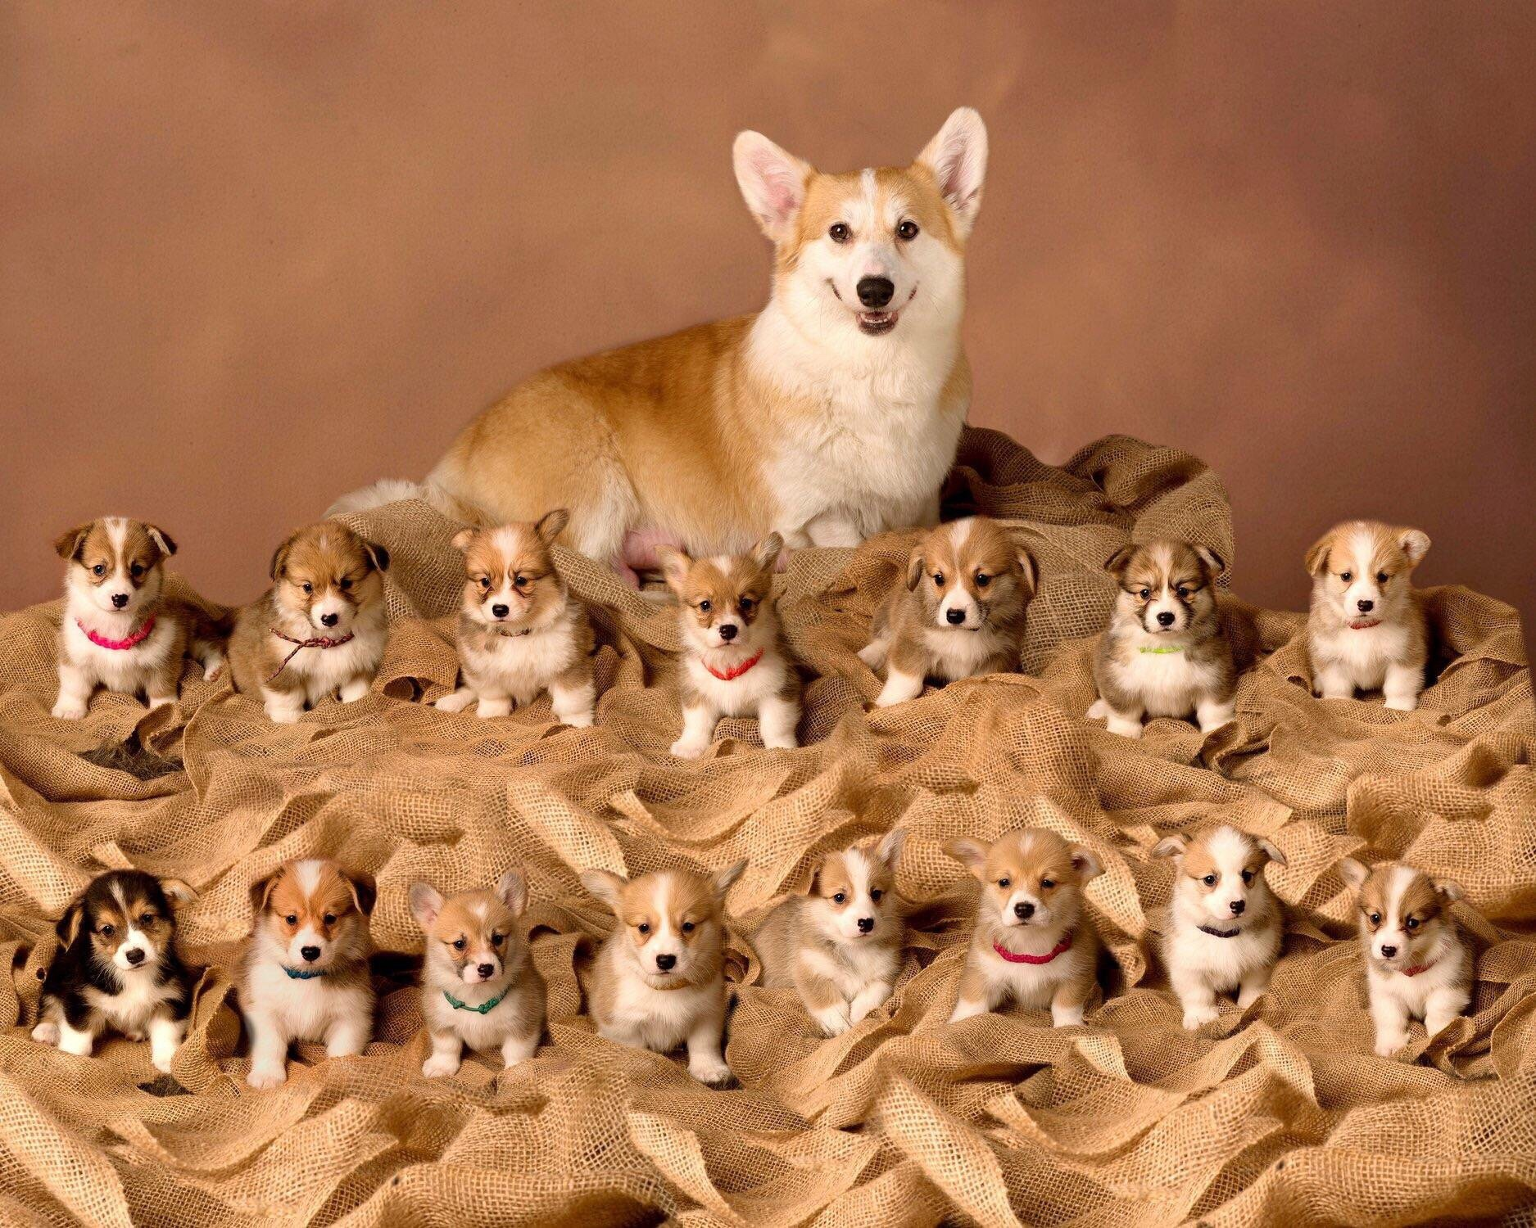

Slide 19

Services

Slide 20

Services

Slide 21
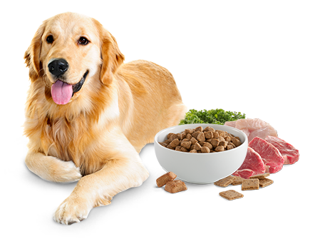
Healthy food

Slide 22
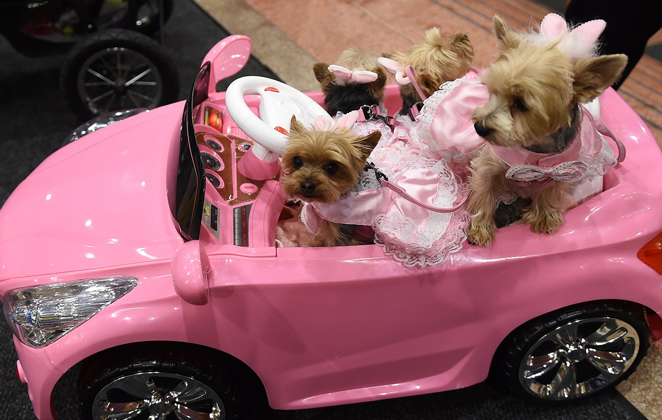
Luxury

Slide 23
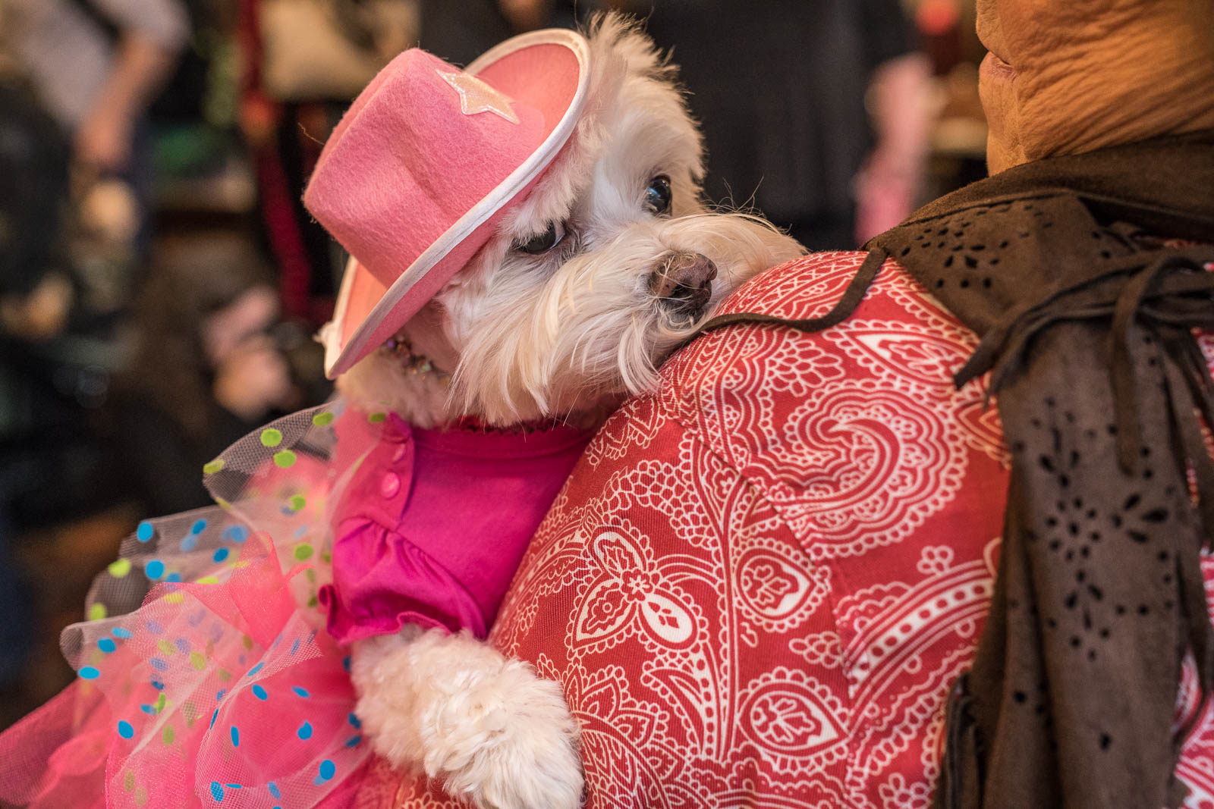
Fashion

Slide 24
Introduction - Actual requirements
Building a website to enter e-commerce market of Pet
Services
Shop
Pet Dating

Slide 25
Functional
Admin
View
Insert
Delete
Update
User
Register
Booking
Buying
View
Booking
Take part
Notes:
Non-functional (how the system works)
Functional (what the system should do)

Slide 26
Requirements of the project
HARDWARE | SERVER
 | Minimum | Recommended
Processor | 800 MHz Intel Pentium III
Memory | 2 GB | 4 GB
Disk space | 8 GB | 16 GB
Monitor | Super-VGA (800x600) or higher resolution monitor
Internet | Internet access is required
 | CLIENT
Processor | 800 MHz Intel Pentium III
Memory | 512 MB
Monitor | Super-VGA (800x600) or higher resolution monitor
Internet | Internet access is required
SOFTWARE | SERVER
Operating System | Windows XP or later
Browser | Google Chrome 65.0
Database | Microsoft SQL Server 2014
Software | Java SDK 1.8
 | GlassFish Server 4.0
 | CLIENT
Operating System | Windows XP or later
Browser | Google Chrome 65.0
Notes:
Non-functional (how the system works)
Functional (what the system should do)

Slide 27
Requirements of the project
Non-functional
DEVELOPMENT SOFTWARE
Microsoft Windows 10
TECHNOLOGY
J2EE
Java SDK 1.8
Netbeans IDE 8.2
Atom 1.36
SQL Server 2016
Google Chrome 74.0
WampServer 3.1.3
Glassfish server 4.1.0
EJB
HTML/CSS
JavaScript
Angular 7
REST API
JWT Token 0.9.1
Node.JS and NPM
Notes:
Non-functional (how the system works)
Functional (what the system should do)

Slide 28
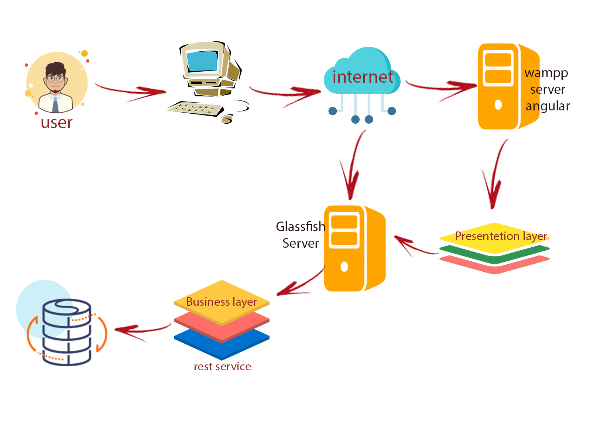
Introduction - Deployment diagram

Slide 29
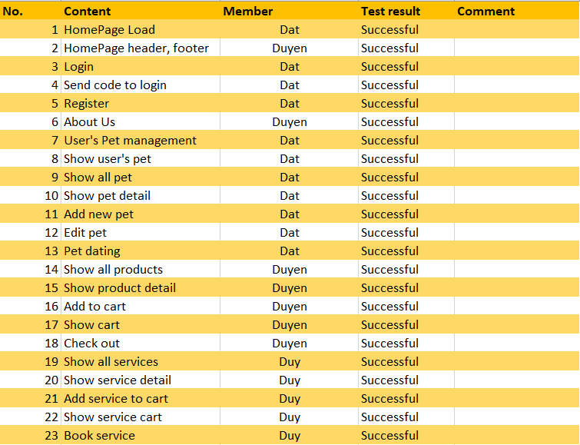
Test Result [1-2]

Slide 30
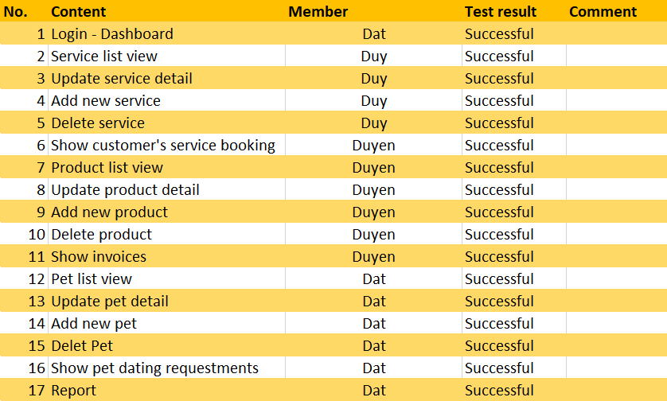
Test Result [2-2]

Slide 31
Task List
Le Cong Dat
Login Mobile
Pet Dating
Tran Thi Tuyet Duyen
Category
Shop
Tran Tan Duy
Register
Services
Report
Logout
Cart
Appointment
Home
Chart
Full calendar
JWT
User

Slide 32
Conclusion
Advantages
- Using new technology, programming, techniques.
- Website GUI is simple, beautiful and attractive.
- With some features of social network
Disadvantages
- Website has fast response.
- Improve performance website
- Improve UI
- Implement payment function

Slide 33

Thank You

